Slide 1
WELCOME

Slide 2

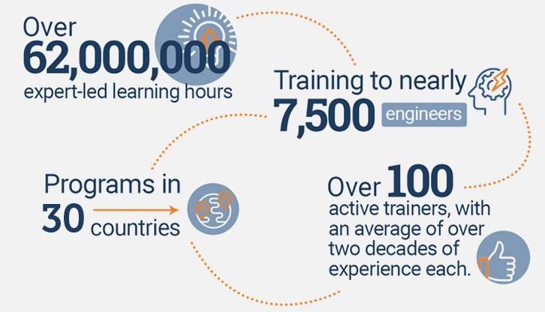
An Overview
Our purpose…
We help organizations learn and adopt new technologies.
In 2018 alone...
…Impacts you daily.
When you talk on the phone, watch a movie, connect with friends on social media, drive a car, fly on a plane, pay with a credit card, shop online, and order a latte with your mobile app, you are interacting with technology developed by one of our customers.
Notes:
Share a bit about DevelopIntelligence
- As developers you want to learn!
- As a corporation you want your developers to align their learning with your business goals.
- That’s where we come in… Keeping developers current, bringing others up-to-speed … all aimed at moving your business forward!
- We started in 2003 by a Sun Microsystems developer that wanted to help developers level-up and see business better leverage IT

Slide 3
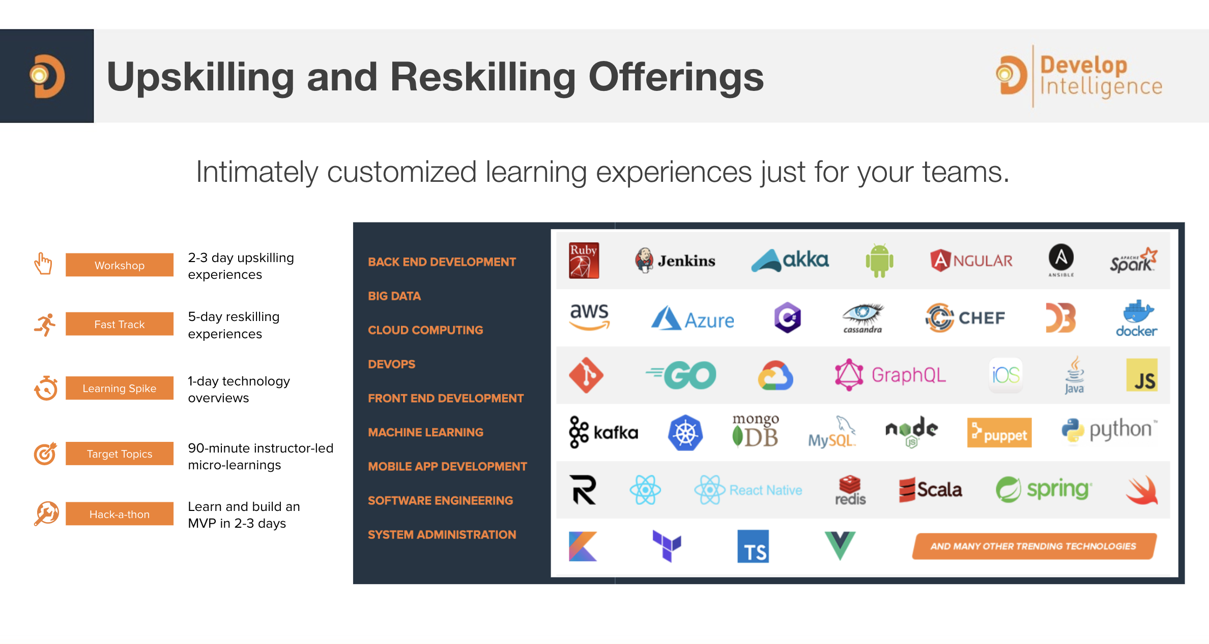
Technologies we cover
Notes:
Areas of DevelopIntelligence expertise
DevOps: Ansible / Jenkins
BigData: Hadoop / Cassandra / Spark
Machine Learning
Front-end: React / Angular
Cloud: AWS / Azure / Google Cloud
- Started as a Java shop -> keep growing -> haven’t looked back
- Our specialty is hiring expert practitioners that can come alongside teams and teach them how to move forward

Slide 4
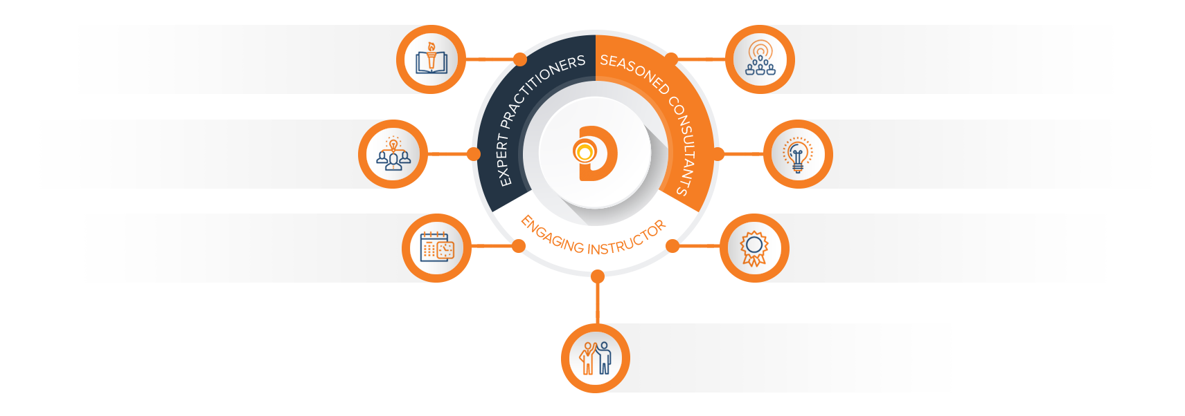
Our Practitioners
250 best selling
books authored
150 engagements speaking
at industry conferences
9+ years of training
experience
Over 17 years of industry
experience per instructor
750,000 practitioner led
training hours
125 certifications in leading
technologies
95% instructor satisfaction

Slide 5
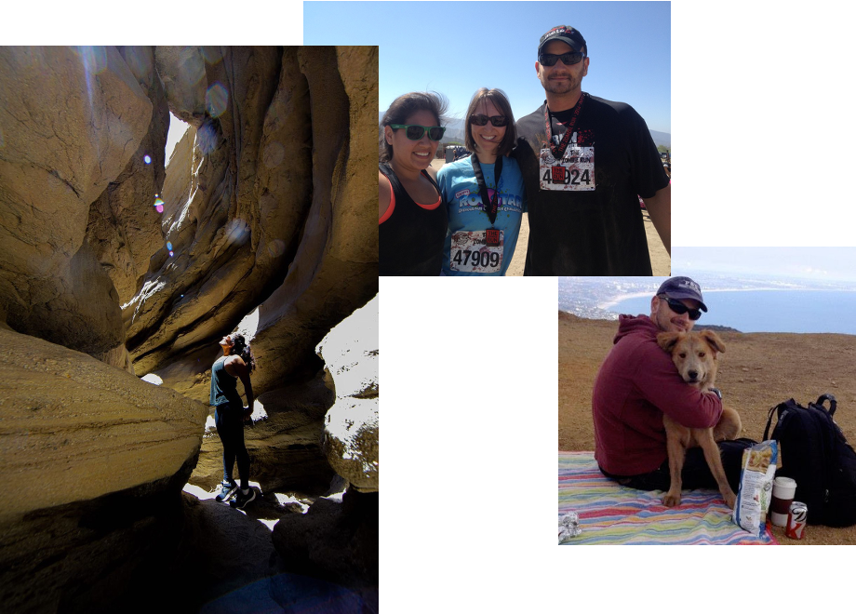
About the instructors

Slide 6
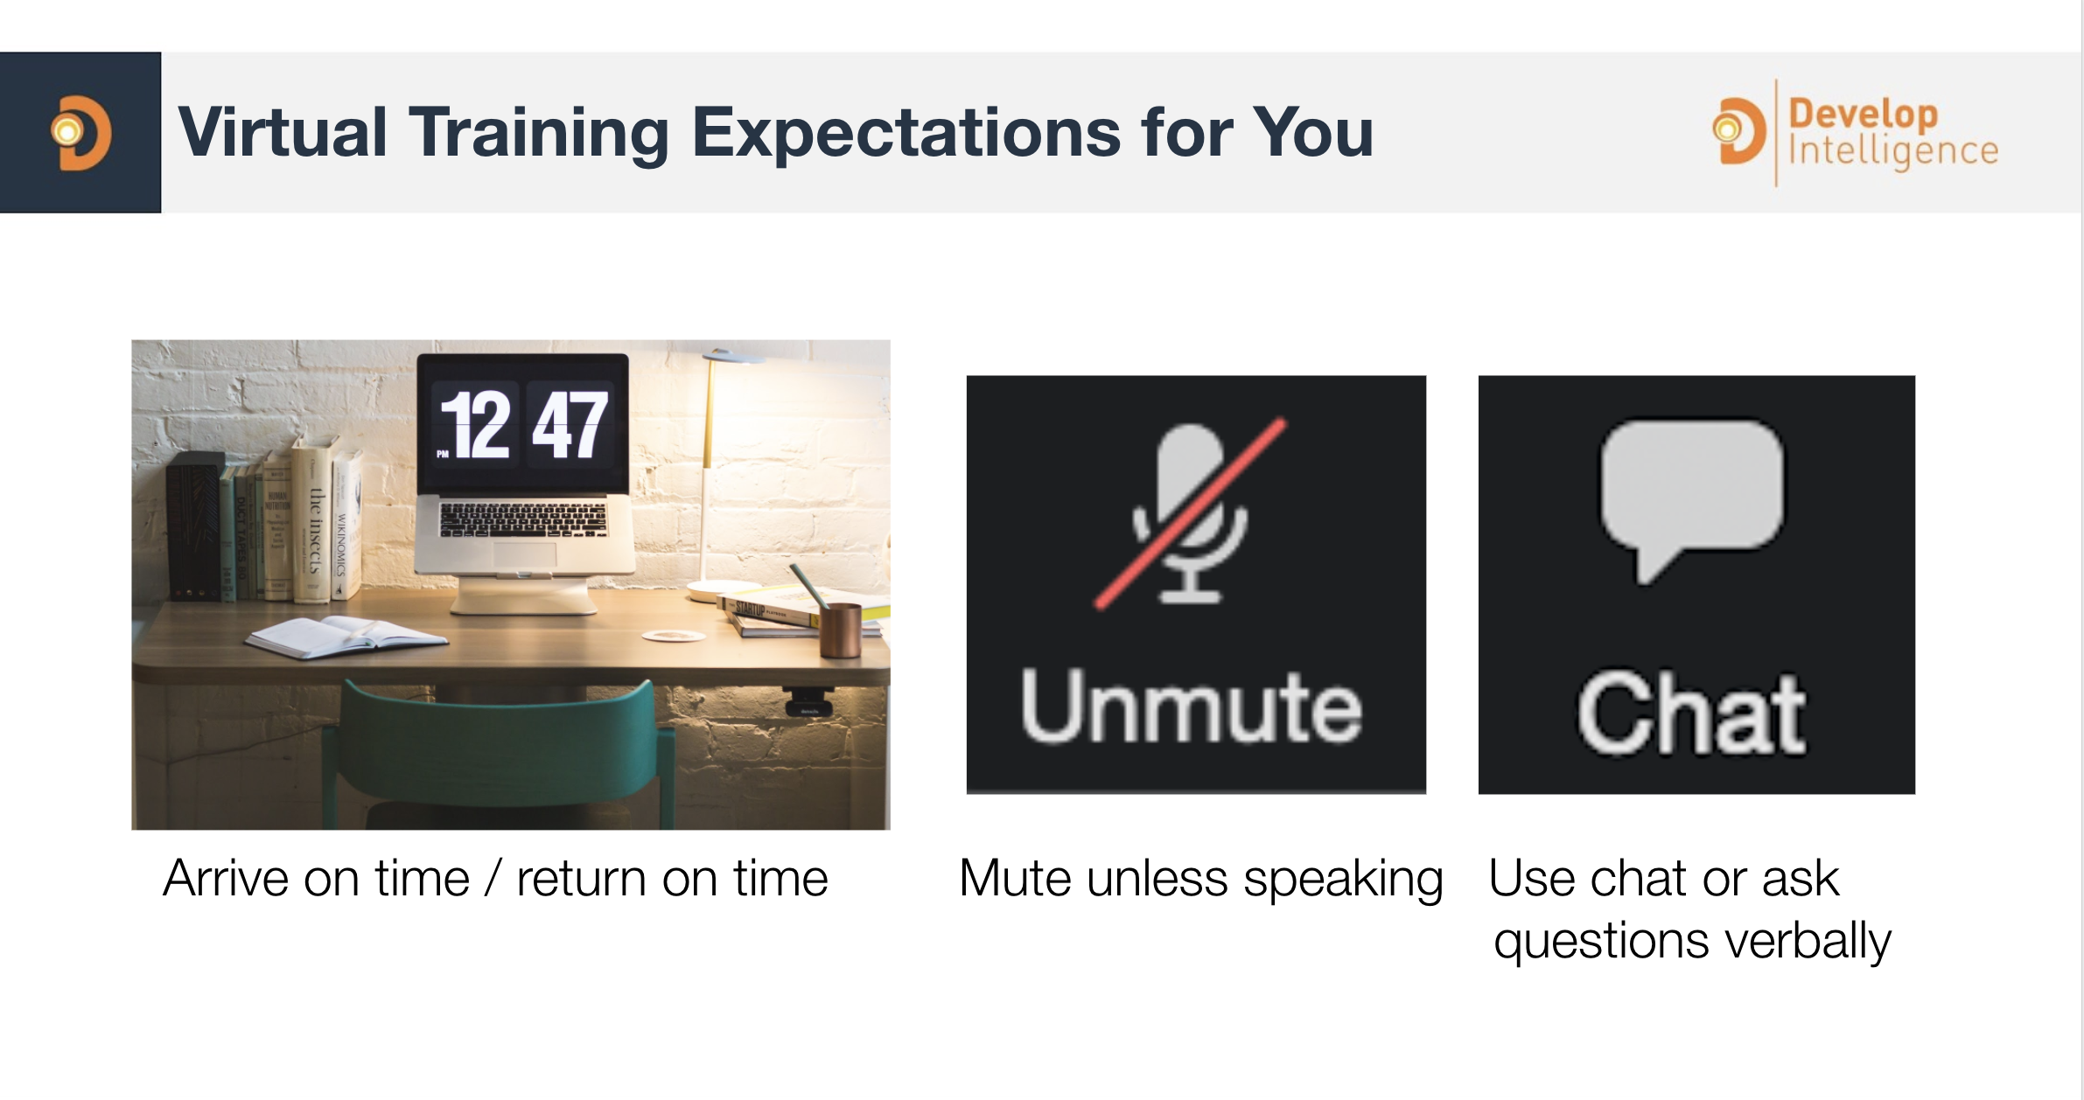

Slide 7
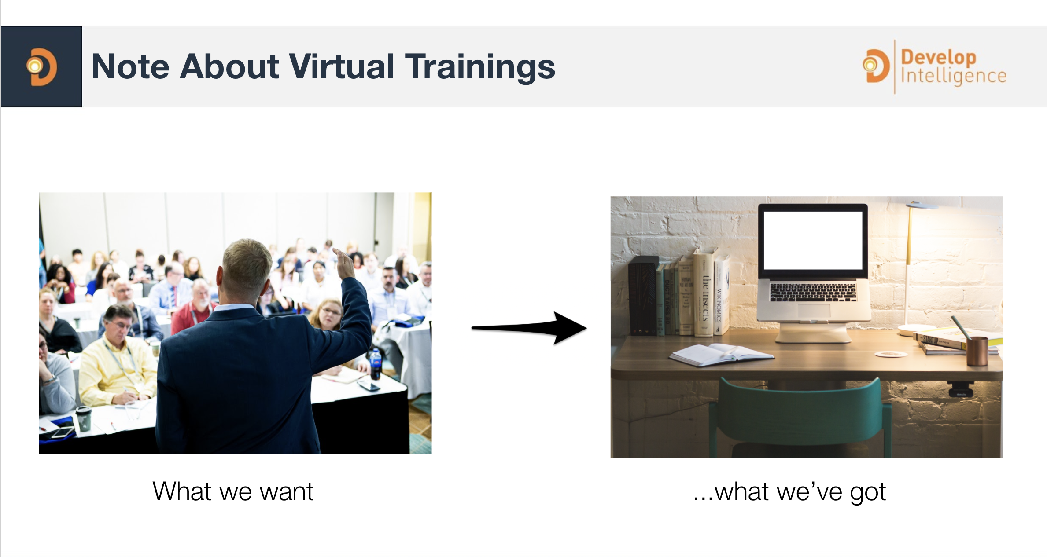

Slide 8
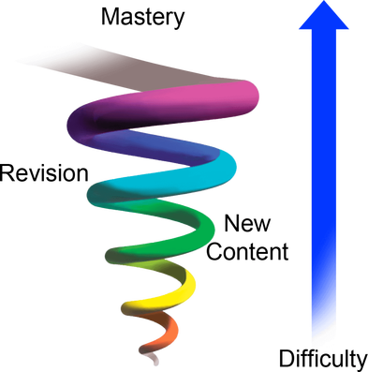
Spiral Approach
Revisiting content to get a better understanding
Increasing difficulty each time
If I am going too fast please let me know
Please ask questions
I encourage discussions on items that interest you
Notes:
There is a lot of material to cover and I have clearly added notes to most of the slides. I encourage discussions to happen around items that interest you! This class if for your Org on how it can be beneficial to you.
I pledge to:
Make this as interesting and interactive as possible
Ask questions in order to stimulate discussion
Use whatever resources I have at hand to explain the material
Try my best to manage verbal responses so that everyone who wants to speak can do so
Use an on-screen timer for breaks so you know when to be back

Slide 9
Overall Objective
There is a lot of content and techniques that are provided in the course
The Goal of the course is not for you to know every single item inside and out but to see how they work together and how you can utilize them to work for your organization.

Slide 10
Agenda
Day 1 Intro and Fundamentals | Day 2 Advanced SQL Intensive | Day 3
Introduction to Data Engineering | Execution Plans | Snowflake review plus clustering and micro-partitions
Lab 1 : Working with your Product Owner | Lab 3 : Concurrency and query Caching | Lab 7 : Clustering and Micro-Partitions under the hood
AWS and Cloud Fundamentals | SQL Select and all that follows | Transforming and dbt
Lab 2 : Using what you learned from you product owner to design your database | Lab 4 : Fix a Query | Lab 8 : dbt tests & models
 | Efficiency in multi-table queries | Optimizing reporting and other tools to increase performance
Fun Lab : Jeoparty! – overview of what you learned round 1 | Lab 5 : CTEs and recursive CTEs | Fun Lab : Final Jeoparty – final discussions on the day
 | Updating Tables & Continuous data protection
 | Fun Lab : Jeoparty – double Jeopardy of what you learned round 2

